Slide 1

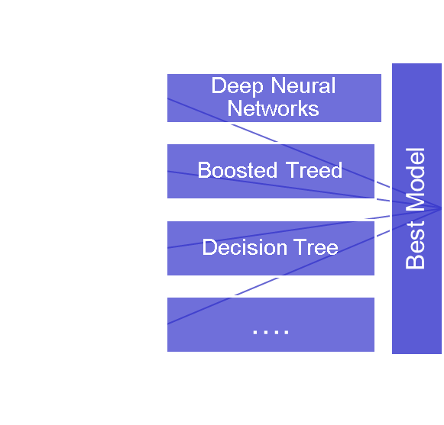
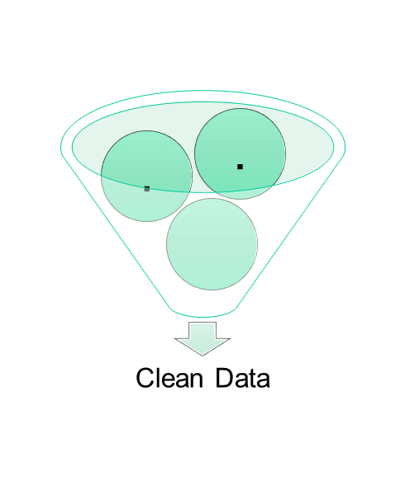
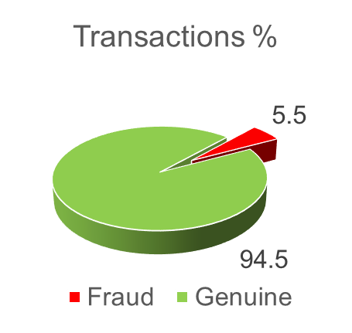
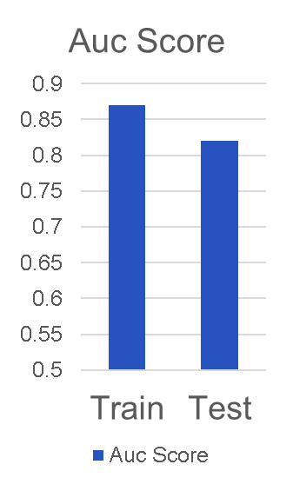

Fraud Detection
Input Data
Data
PreProcessing
Input Data
Modeling
Output
Model for Alert Feedback
* Current Churn Rate – 6.9%
Concept Drift
* Concepts in Red Star, to be added to the future industrial strength model for RTR capabilities
Notes:
‹#›

